Slide 1
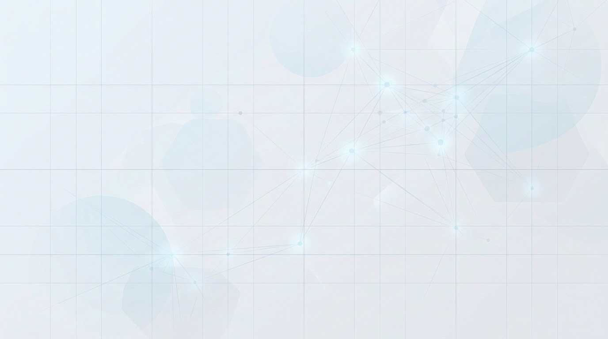
Swapnadeep Das
College Name: VIT Vellore
Roll no.: 25MML0034
Project 1 Title: Hybrid Predictive-Generative Customer Retention: Integrating Tabular Churn Prediction with RAG-Powered Knowledge Retrieval
Project 2 Title: Data Narrator: Multi-Agent NL-to-SQL BI Copilot with Autonomous Self-Correction and Insights

Slide 2
Hybrid Predictive-Generative Customer Retention: Integrating Tabular Churn Prediction with RAG-Powered Knowledge Retrieval
Problem & Objectives:
The Problem: Traditional retention systems rely on batch processing. By the time models predict churn, the customer has already decided to leave. Standard AI lacks automated, context-aware intervention.
Core Objectives:
Stream Ingestion: Use Apache Kafka for sub-second data streaming.
Real-Time ML: Instant risk scoring via Mini-Batch K-Means & XGBoost.
Action via RAG: Trigger local LLMs (Ollama) to generate policy-compliant retention offers offline, in real-time.
Dataset Strategy
1. Tabular Event Stream (ML Training): The public IBM Telco Churn dataset is refactored into a live Kafka message stream. This simulates real-time network behavior, allowing dynamic clustering based on tenure, charges, and support tickets.
2. Synthetic Knowledge Base (RAG): A curated corpus of enterprise SLAs, discount policies, and FAQs embedded into ChromaDB. This grounds the local offline LLM, ensuring it retrieves factual policies and prevents AI hallucinations.

Slide 3
TECHNICAL STACK:
Streaming: Apache Kafka
AI / ML: Scikit-learn, XGBoost
Offline RAG: LangChain, ChromaDB,
DevOps: Docker Compose, GitHub Actions
EXPECTED OUTCOMES:
Live customer segmentation executing dynamically upon event arrival.
Instantaneous, hallucination-free retention interventions using free, offline local LLMs.

Slide 4
Data Narrator: Multi-Agent NL-to-SQL BI Copilot with Autonomous Self-Correction and Insights
Problem Statement:
Business users wait 2-5 days for SQL reports. Current tools fail due to schema hallucinations and lack of execution safety.
Core Objectives:
Build a LangGraph & Llama 3.1 multi-agent system. Implement safe, read-only SQL generation. Automate visual charts and executive summaries.
Dataset Strategy:
Source: Northwind & Chinook enterprise schemas.
Format: Multi-table PostgreSQL database.
Relevance: Simulates real-world operational and relational complexity.

Slide 5
TECHNICAL STACK:
Agents: LangGraph, Ollama (Llama 3.1 8B).
Database: PostgreSQL, psycopg2.
Interface: Streamlit, Plotly charts.
EXPECTED OUTCOMES:
A self-serve BI copilot translating plain English to safe SQL, autonomously correcting its own errors, and rendering interactive charts in under 10 seconds.

